Slide 1

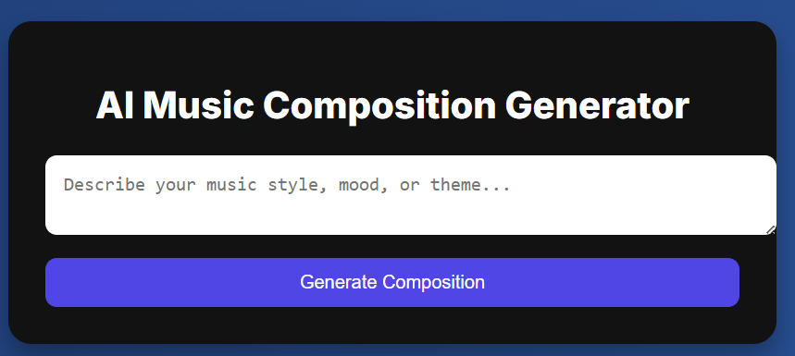

Introducing : AI-Powered Music Composition
This is revolutionizing music creation with artificial intelligence. It is intelligent, intuitive, and inspiring. It is perfect for musicians, composers, and hobbyists. Experience the future of music composition today.
ST
by SAVEYA TEAM

Slide 2
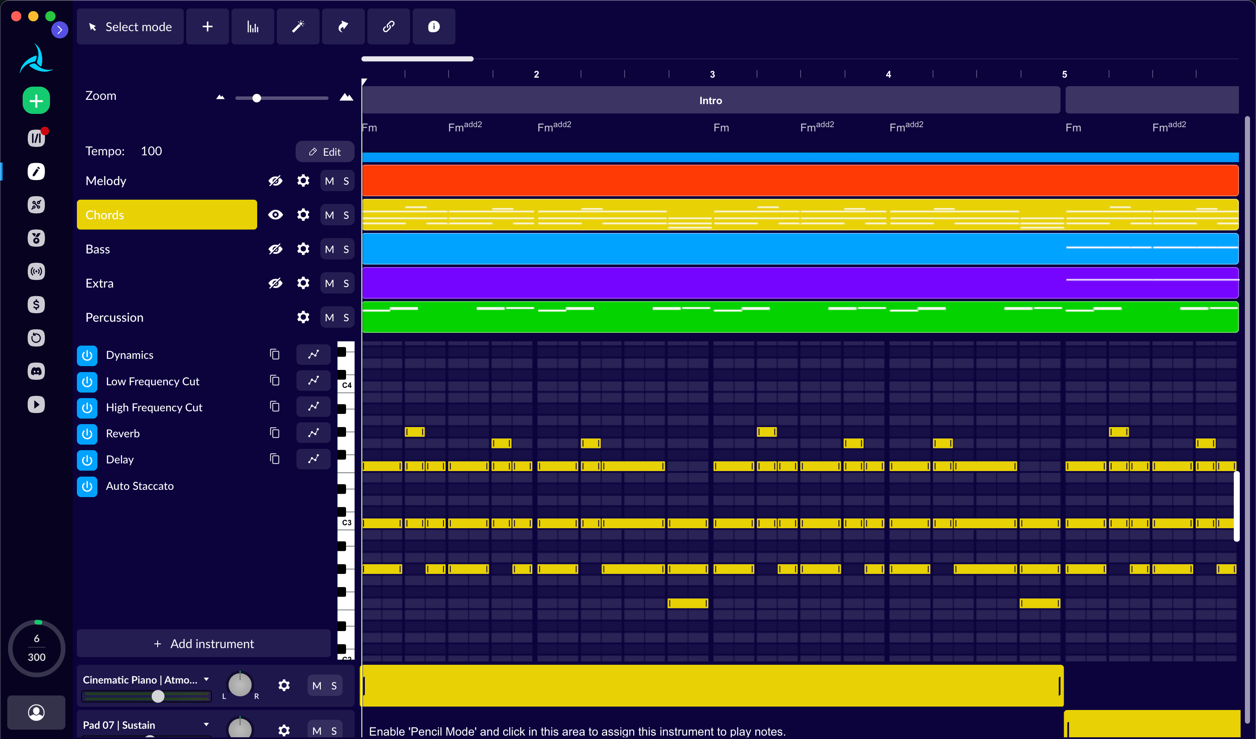
Key Features
AI-Driven Melody Generation
Harmonic Accompaniment
Creates unique melodic lines to spark your creativity.
Generates chords and harmonies for rich soundscapes.
Rhythmic Variations
Creates dynamic drum patterns to add rhythm.

Slide 3
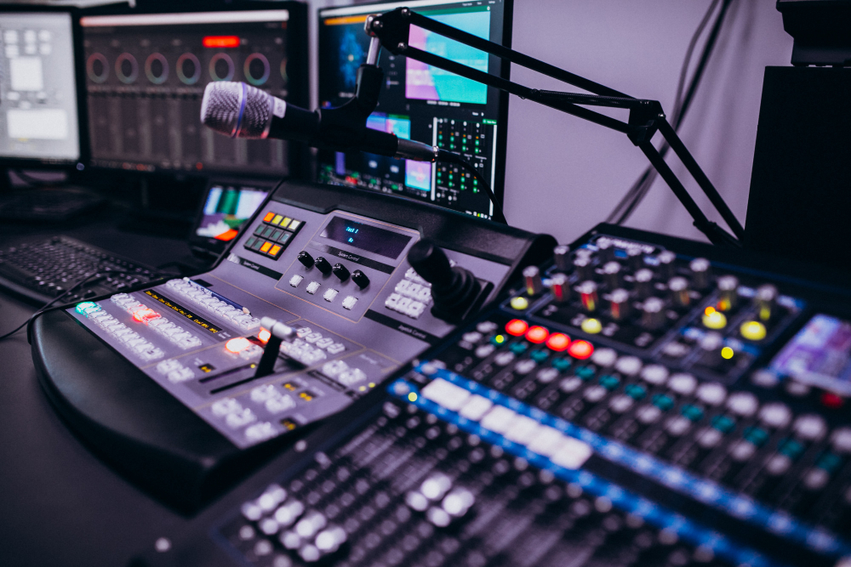




The Benefits of Using AI MUSIC
Accelerate Creation
Overcome Blocks
Explore Genres
Cost-Effective
This model helps you finish projects faster. It provides fresh ideas, and it's accessible to all skill levels.

Slide 4




How AI MUSIC GENERATOR Works
Deep Learning Models
Trained on vast music libraries.
Generative lyrics
Create original compositions.
User Input
Guides AI with preferences.

Slide 5
AI Music Composition vs. Traditional Tools
Automation vs. Manual
Inspiration
AI handles tedious tasks, freeing you to focus on creativity.
AI generates unique ideas, breaking free from templates.

Slide 6
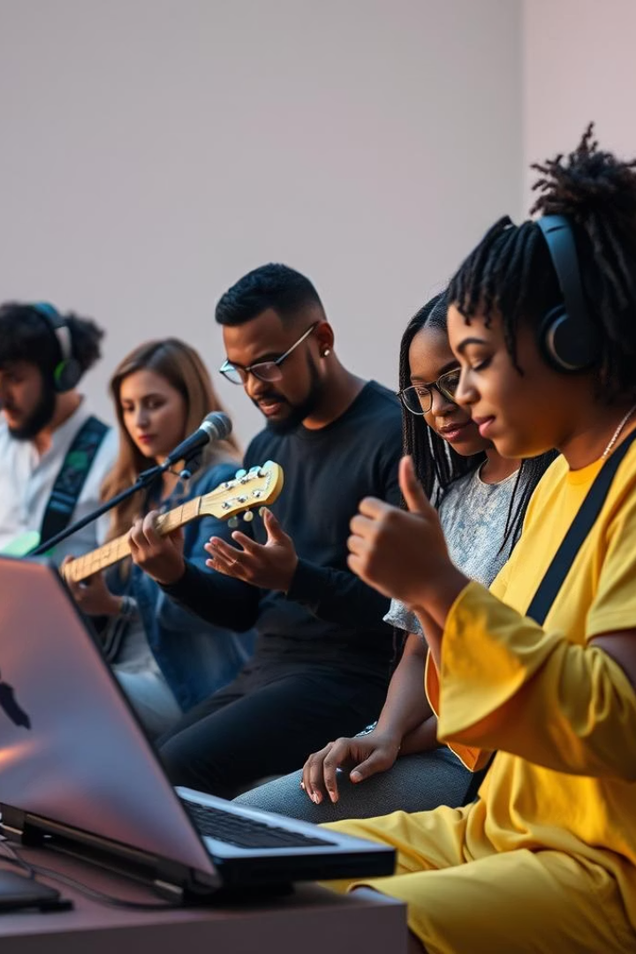
Who Can Benefit from AI Composition ?
Film Scoring
Game Development
Generate background music and themes quickly.
Create unique soundtracks for immersive experiences.
Songwriting
Compose melodies and harmonies effortlessly.

Slide 7
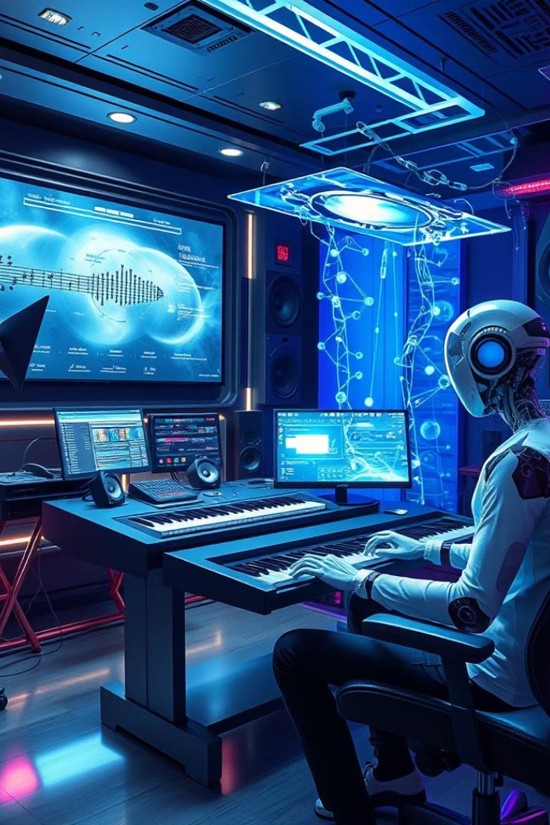
The Future of AI Composition
1
Enhanced AI Models
Even more realistic compositions.
2
Expanded Instrument Library
Wider range of sounds.
3
Plugin Integration
Seamless workflow with DAWs.

Slide 8
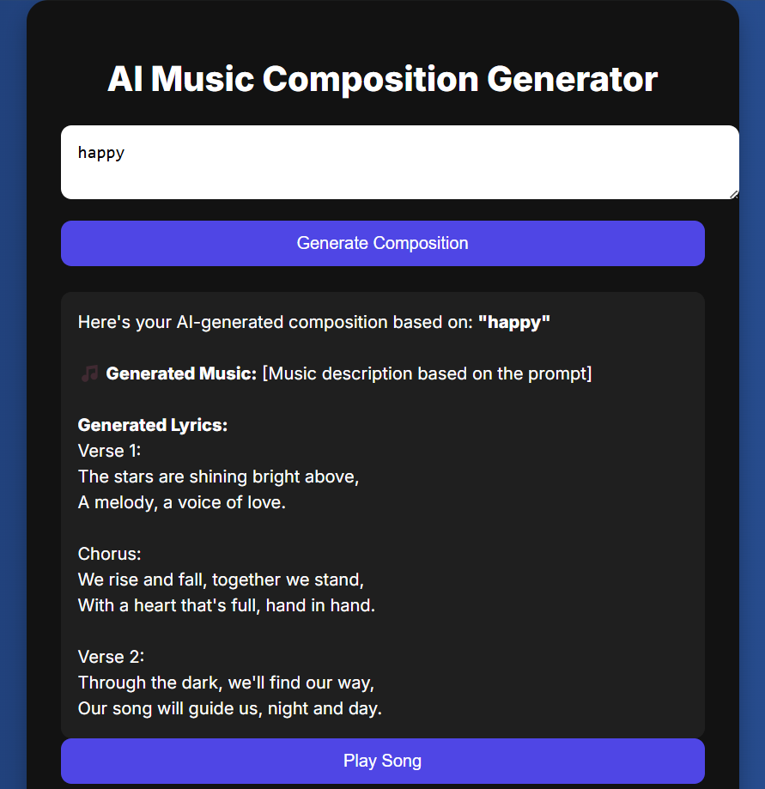
Unleash Your Musical Potential
AI-powered music composition for all skill levels. Accelerate your creativity, overcome creative blocks, and explore new genres. Join the future of music with Ai music generator today!

